Slide 1
General Purpose I/O

Slide 2
Overview
How do we make a program light up LEDs in response to a switch?
Circuit Interfacing
GPIO Peripheral
Hardware
Software
Miscellaneous

Slide 3
Interfacing
Inputs and Outputs, Ones and Zeros, Voltages and Currents

Slide 4
Basic Concepts
Goal: light either LED1 or LED2 based on switch SW1 position
GPIO = General-purpose input and output (digital)
Input: program can determine if input signal is a 1 or a 0
Output: program can set output to 1 or 0
Can use this to interface with external devices
Input: switch
Output: LEDs

Slide 5
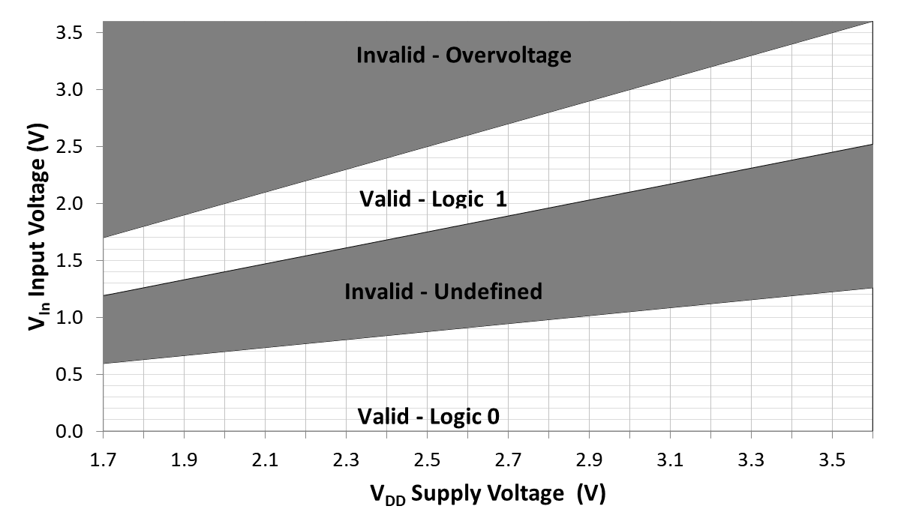
Inputs: What’s a One? A Zero?
Input signal’s value is determined by voltage
Input threshold voltages depend on supply voltage V_{DD}
Exceeding V_{DD} or GND may damage chip

Slide 6
Outputs: What’s a One? A Zero?
Nominal output voltages
1: V_{DD}-0.5 V to V_{DD}
0: 0 to 0.5 V
Note: Output voltage depends on current drawn by load on pin
Need to consider source-to-drain resistance in the transistor
Above values only specified when current < 5 mA (18 mA for high-drive pads) and V_{DD} > 2.7 V
Logic 1 out
V_{out}
Logic 0 out
I_{out}

Slide 7
Output Example: Driving LEDs
Need to limit current to a value which is safe for both LED and MCU port driver
Use current-limiting resistor
R = (V_{DD} – V_{LED})/I_{LED}
Set I_{LED} = 4 mA
V_{LED} depends on type of LED (mainly color)
Red: ~1.8V
Blue: ~2.7 V
Solve for R given VDD = ~3.0 V
Red: 300 Ω
Blue: 75 Ω
Demonstration code in Basic Light Switching Example

Slide 8
GPIO Peripheral Hardware

Slide 9
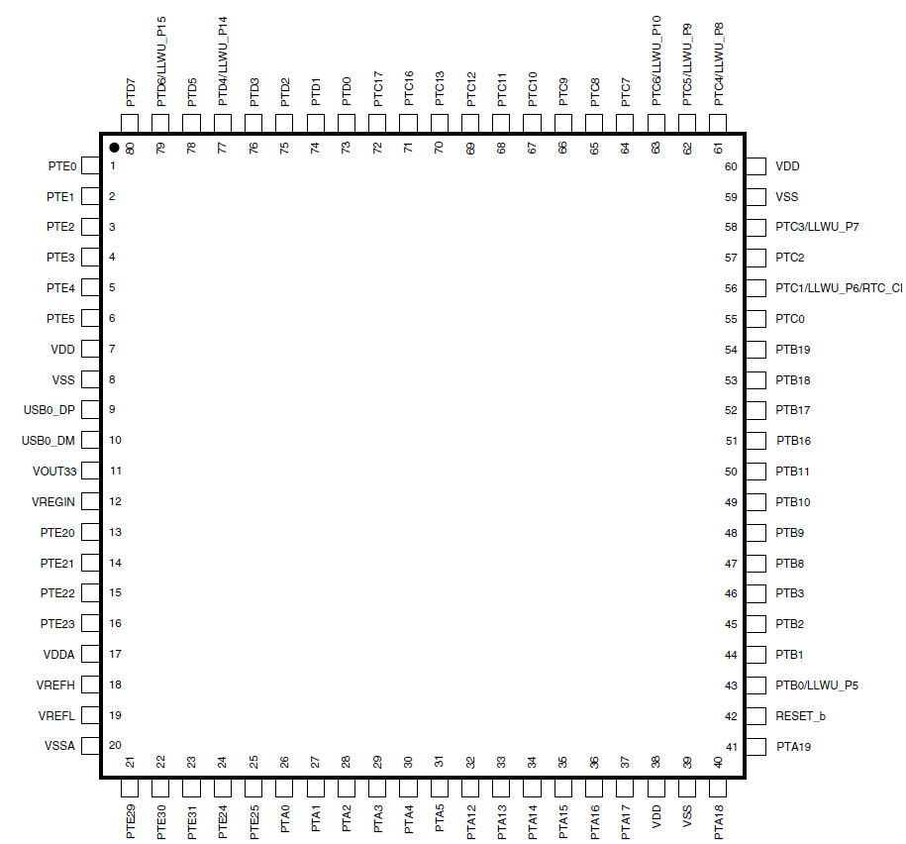
KL25Z GPIO Ports
Port A (PTA) through Port E (PTE)
Not all port bits are available
Quantity depends on package pin count
Notes:
The pins on the KL25Z available for GPIO are marked in tan.

Slide 10
Sharing MCU Pins
Data
GPIO
Data
Data
PORTA
UART0
CPU
TPM2
Clock signals
SIM
Data
PORTA Bit 1
GPIO
Data
UART0
TPM2
PORTA_PCR1
MUX

Slide 11
GPIO Port Bit Circuitry in MCU
Control
Direction
MUX
Data
Output (different ways to access it)
Input
Notes:
There is quite a bit of circuitry associated with a GPIO port bit. The connection between package and the external circuit is a pin or a pad, and is shown on the far right. We will examine this circuit in more detail in the next few slides. Various properties can be configured using the control registers, and data can either be written out or read in.

Slide 12
Connecting a GPIO Signal to a Pin
Multiplexer used to increase configurability - what should pin be connected with internally?
Each configurable pin has a Pin Control Register
Notes:
Next we need to make sure the GPIO signal is connected to the pin on the package. This is done with the multiplexer (trapezoid on right), which is an electronic switch.

Slide 13
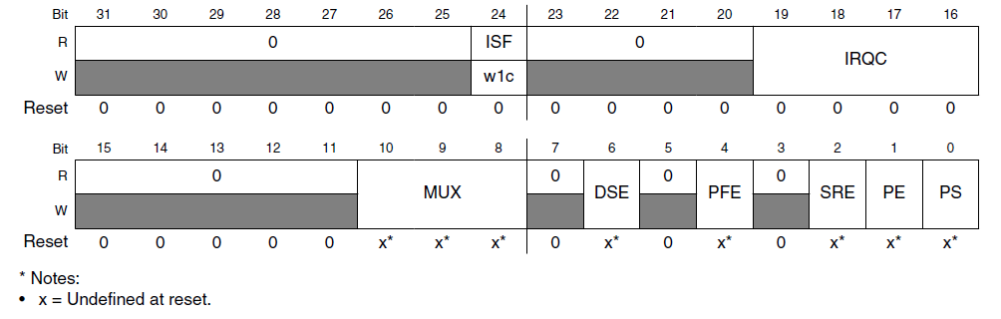
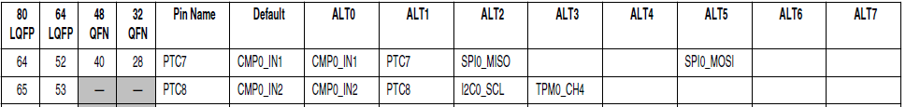
Pin Control Register
MUX (bits 10-8) | Configuration
000 | Pin disabled (analog)
001 | Alternative 1 – GPIO
010 | Alternative 2
011 | Alternative 3
100 | Alternative 4
101 | Alternative 5
110 | Alternative 6
111 | Alternative 7
MUX field of PCR defines connections
Notes:
The Pin Control Register has a field called MUX which controls the multiplexer, connecting the external pin to a particular internal signal. Each pin has different possible internal signals, detailed in the MCU reference manual.

Slide 14
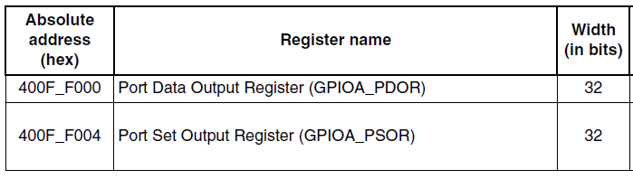
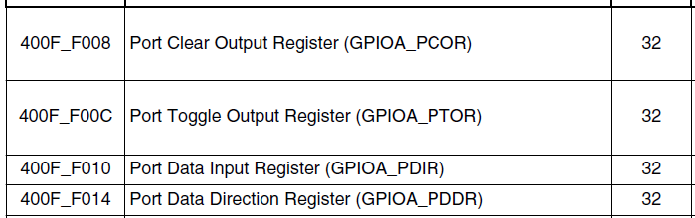
Control Registers
One set of control registers per port
Each bit in a control register corresponds to a port bit
Notes:
Here are the control registers. Let’s look at what they do.

Slide 15
PDDR: Port Data Direction
Each bit can be configured differently
Input: 0
Output: 1
Reset clears port bit direction to 0
Notes:
The PDDR determines if a port bit’s direction is an input or an output.

Slide 16
Writing Output Port Data
Direct: write value to PDOR
Toggle: write 1 to PTOR
Clear (to 0): Write 1 to PCOR
Set (to 1): write 1 to PSOR

Slide 17
Reading Input Port Data
Read from PDIR
Corresponding bit holds value which was read

Slide 18
GPIO Peripheral Software

Slide 19
Pseudocode for Program
// Make PTA1 and PTA2 outputs
set bits 1 and 2 of GPIOA_PDDR
// Make PTA5 input
clear bit 5 of GPIOA_PDDR
// Initialize the output data values: LED 1 off, LED 2 on
clear bit 1, set bit 2 of GPIOA_PDOR
// read switch, light LED accordingly
do forever {
if bit 5 of GPIOA_PDIR is 1 { // switch is not pressed, so light LED 2
set bit 2 of GPIOA_PDOR
clear bit 1 of GPIO_PDOR
} else { // switch is pressed, so light LED 1
set bit 1 of GPIOA_PDOR
clear bit 2 of GPIO_PDOR
}
}
Notes:
Let’s look at a simple program which reads a switch and then lights one of two LEDs, depending on whether the switch is pressed or not. Here is the pseudocode.

Slide 20
Coding Style and Bit Access
Easy to make mistakes dealing with literal binary and hexadecimal values
“To set bits 13 and 19, use 0000 0000 0000 1000 0010 0000 0000 0000 or 0x00082000”
Make the literal value from shifted bit positions
n = (1UL << 19) | (1UL << 13);
Define names for bit positions
#define GREEN_LED_POS (19)
#define YELLOW_LED_POS (13)
n = (1UL << GREEN_LED_POS) | (1UL << YELLOW_LED_POS);
Create macro to do shifting to create mask
#define MASK(x) (1UL << (x))
n = MASK(GREEN_LED_POS) | MASK(YELLOW_LED_POS);

Slide 21
Using Masks
Overwrite existing value in n with mask
n = MASK(foo);
Set in n all the bits which are one in mask, leaving others unchanged
n |= MASK(foo);
Use the complement of the mask’s bit value
~MASK(foo)
Clear in n all the bits which are zero in mask, leaving others unchanged
n &= MASK(foo);

Slide 22
CMSIS Overview
What is CMSIS?
Hardware Abstraction Layer: Layer of software between application program and hardware
Conventions and standards for software interfaces, structure and names
Problem – too many options
Some Cortex-M architectures offer additional instructions
When targeting Cortex-M4, compiler has additional instructions available (e.g. floating point, SIMD) compared with M0+
Many MCU vendors create Cortex-M-based MCUs
Although CPU cores are consistent, peripherals are structured and accessed differently
Many compilers available
Different approaches to implementing features not defined in C/C++ specifications
Many RTOSs available
Different APIs
Benefits
Shortens learning curve on new hardware
Simplifies software development
Simplifies software reuse

Slide 23
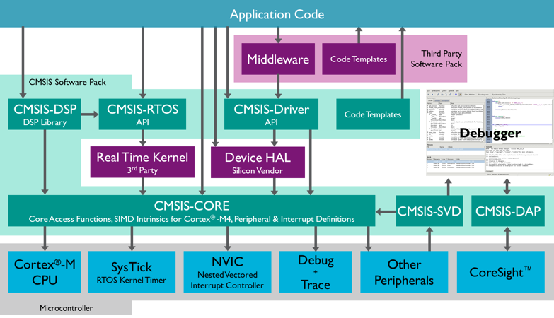
CMSIS Structure
Detailed documentation available through MDK: Help->Open Books Window, then select Tool User’s Guide-> CMSIS Documentation
Notes:
One major benefit of CMSIS is that it standardizes the structure and interfaces between the components shown here, enabling interoperability and simplifying development.

Slide 24
Example: Accessing Hardware Registers in C
Header file MKL25Z4.h
Declares pointers to the registers
/* GPIO - Peripheral instance base addresses */
/** Peripheral PTA base address */
#define PTA_BASE (0x400FF000u)
/** Peripheral PTA base pointer */
#define PTA ((GPIO_Type *)PTA_BASE)
PTA->PDOR = my_data;

Slide 25
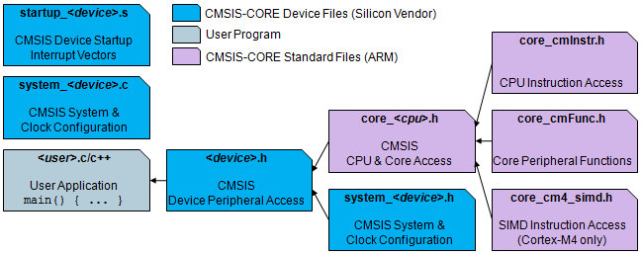
Example: Accessing Hardware Registers in C
Header file MKL25Z4.h
Defines C data structure types to represent MCU hardware registers
/** GPIO - Register Layout Typedef */
typedef struct {
__IO uint32_t PDOR; /**< Port Data Output Register, offset: 0x0 */
__O uint32_t PSOR; /**< Port Set Output Register, offset: 0x4 */
__O uint32_t PCOR; /**< Port Clear Output Register, offset: 0x8 */
__O uint32_t PTOR; /**< Port Toggle Output Register, offset: 0xC */
__I uint32_t PDIR; /**< Port Data Input Register, offset: 0x10 */
__IO uint32_t PDDR; /**< Port Data Direction Register, offset: 0x14 */
} GPIO_Type;

Slide 26
Example: Using The Ports
#include <MKL25Z4.h>
#define LED1_POS (1)
#define LED2_POS (2)
#define SW1_POS (5)
#define MASK(x) (1UL << (x))
PTA->PDDR |= MASK(LED1_POS) | MASK(LED2_POS); // set bits to outputs
PTA->PDDR &= ~MASK(SW1_POS); // clear switch bit to input
PTA->PDOR = MASK(LED2_POS); // turn on LED1, turn off LED2
while (1) {
if (PTA->PDIR & MASK(SW1_POS)) { // switch is not pressed, so light LED 2
PTA->PDOR = MASK(LED2_POS);
} else { // switch is pressed, so light LED 1
PTA->PDOR = MASK(LED1_POS);
}
}
Notes:
Here we see how to use CMSIS to access port A for GPIO.

Slide 27
C Code
// Turn on LED with 0 output, turn off with 1
// Switch input is 0 when pressed, 1 when released
#define LED1_POS (1)
#define LED2_POS (2)
#define SW1_POS (5)
#define MASK(x) (1UL << (x))
PTA->PDDR |= MASK(LED1_POS) | MASK (LED2_POS); // set LED bits to outputs
PTA->PDDR &= ~MASK(SW1_POS); // clear Switch bit to input
PTA->PDOR = MASK(LED2_POS); // turn on LED1, turn off LED2
while (1) {
if (PTA->PDIR & MASK(SW1_POS)) {
// switch is not pressed, then light LED 2
PTA->PDOR = MASK(LED2_POS);
} else {
// switch is pressed, so light LED 1
PTA->PDOR = MASK(LED1_POS);
}
}
Notes:
Here is the C code based on the pseudocode. Note how it uses the CMSIS constructs described previously. We have to add a few pieces of code to make the whole system work properly.

Slide 28
Pin Use Checklist
Data
Data
SIM: Enable logic clock signals to…
Pin’s Port module
Peripheral module (may or may not be Port)
Configure pin control multiplexer
Configure peripheral
Configure interrupt system (if needed)
GPIO
Data
PORTA
UART0
CPU
TPM2
Clock signals
SIM

Slide 29
Clocking Logic
Bit | Port
13 | PORTE
12 | PORTD
11 | PORTC
10 | PORTB
9 | PORTA
Need to enable clock to GPIO module
By default, GPIO modules are disabled to save power
Writing to an unclocked module triggers a hardware fault!
Control register SIM_SCGC5 gates clocks to GPIO ports
Enable clock to Port A
SIM->SCGC5 |= (1UL << 9);
Header file MKL25Z4.h has definitions
SIM->SCGC5 |= SIM_SCGC5_PORTA_MASK;
Notes:
First we need to enable the clock to the GPIO module before trying to use it.

Slide 30
CMSIS C Support for PCR
MKL25Z4.h defines PORT_Type structure with a PCR field (array of 32 integers)
/** PORT - Register Layout Typedef */
typedef struct {
__IO uint32_t PCR[32]; /** Pin Control Register n, array offset: 0x0, array step: 0x4 */
__O uint32_t GPCLR; /** Global Pin Control Low Register, offset: 0x80 */
__O uint32_t GPCHR; /** Global Pin Control High Register, offset: 0x84 */
uint8_t RESERVED_0[24];
__IO uint32_t ISFR; /** Interrupt Status Flag Register, offset: 0xA0 */
} PORT_Type;

Slide 31
CMSIS C Support for PCR
Header file defines pointers to PORT_Type registers
/* PORT - Peripheral instance base addresses */
/** Peripheral PORTA base address */
#define PORTA_BASE (0x40049000u)
/** Peripheral PORTA base pointer */
#define PORTA ((PORT_Type *)PORTA_BASE)
Also defines macros and constants
#define PORT_PCR_MUX_MASK 0x700u
#define PORT_PCR_MUX_SHIFT 8
#define PORT_PCR_MUX(x) (((uint32_t)(((uint32_t)(x))<<PORT_PCR_MUX_SHIFT)) &PORT_PCR_MUX_MASK)

Slide 32
Resulting C Code for Clock Control and Mux
// Enable Clock to Port A
SIM->SCGC5 |= SIM_SCGC5_PORTA_MASK;
// Make 3 pins GPIO
PORTA->PCR[LED1_POS] &= ~PORT_PCR_MUX_MASK;
PORTA->PCR[LED1_POS] |= PORT_PCR_MUX(1);
PORTA->PCR[LED2_POS] &= ~PORT_PCR_MUX_MASK;
PORTA->PCR[LED2_POS] |= PORT_PCR_MUX(1);
PORTA->PCR[SW1_POS] &= ~PORT_PCR_MUX_MASK;
PORTA->PCR[SW1_POS] |= PORT_PCR_MUX(1);
Notes:
We use the CMSIS support to first enable the clock for Port A, and then set up the three pins as GPIO.

Slide 33
Miscellaneous

Slide 34
IOPORT Module (Fast GPIO)
IOPORT and GPIO addresses both access same registers
Clocking is controlled to allow the core to do single cycle access to GPIO register through the IOPORT addresses
Access through GPIO registers is slower, takes several cycles because of use of peripheral bus

Slide 35
FGPIO: Single-Cycle I/O Port
typedef struct {
__IO uint32_t PDOR; /**< Port Data Output Register, offset: 0x0 */
__O uint32_t PSOR; /**< Port Set Output Register, offset: 0x4 */
__O uint32_t PCOR; /**< Port Clear Output Register, offset: 0x8 */
__O uint32_t PTOR; /**< Port Toggle Output Register, offset: 0xC */
__I uint32_t PDIR; /**< Port Data Input Register, offset: 0x10 */
__IO uint32_t PDDR; /**< Port Data Direction Register, offset: 0x14 */
} FGPIO_Type;
#define FPTA_BASE (0xF80FF000u)
/** Peripheral FPTA base pointer */
#define FPTA ((FGPIO_Type *)FPTA_BASE)
FPTA->PDOR = MASK(LED2_POS);

Slide 36
Additional Configuration in PCR
Available on some pins, is MCU-dependent
Optional pull-up and pull-down resistors
Used to ensure input signal voltage is pulled to correct value when floating, disconnected or otherwise high-impedance
PE: Pull Enable. 1 enables the pull resistor
PS: Pull Select. 1 pulls up, 0 pulls down.
Optional high current drive strength
DSE: Set to 1 to drive more current (e.g. 18 mA vs. 5 mA @ > 2.7 V, or 6 mA vs. 1.5 mA @ <2.7 V)

Slide 37
KL25Z Pull-Ups and Pull-Downs
 |  | Bit
Port |  | 0 | 1 | 2 | 3 | 4 | 5 | 6 | 7 | 8 | 9 | 10 | 11 | 12 | 13 | 14 | 15 | 16 | 17 | 18 | 19 | 20 | 21 | 22 | 23 | 24 | 25 | 26 | 27 | 28 | 29 | 30 | 31
 | A | ↕ | ↑ | ↑ | ↑ | ↑ | ↑ |  |  |  |  |  |  | ↑ | ↑ | ↑ | ↑ | ↑ | ↑ | ↑ | ↑ | ↑
 | B | ↑ | ↑ | ↑ | ↑ |  |  |  |  | ↑ | ↑ | ↑ | ↑ |  |  |  |  | ↑ | ↑ | ↑ | ↑
 | C | ↑ | ↑ | ↑ | ↑ | ↑ | ↑ | ↑ | ↑ | ↑ | ↑ | ↑ | ↑ | ↑ | ↑ |  |  | ↑ | ↑
 | D | ↑ | ↑ | ↑ | ↑ | ↑ | ↑ | ↑ | ↑
 | E | ↑ | ↑ | ↑ | ↑ | ↑ | ↑ |  |  |  |  |  |  |  |  |  |  | ↑ | ↑ | ↑ | ↑ | ↑ | ↑ | ↑ | ↑ | ↑ | ↑ |  |  |  | ↑ | ↑ | ↑
Available GPIO and pulls for 80-pin package
↑ pull-up available
↕ pull-up and pull-down available

Slide 38
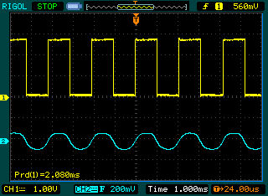
Output Example: Driving a Speaker
Create a square wave with a GPIO output
Use capacitor to block DC value
Use resistor to reduce volume if needed
Write to port toggle output register (PTOR) to simplify code
void Beep(void) {
unsigned int period=20000;
while (1) {
PTC->PTOR = MASK(SPKR_POS);
Delay(period/2);
}
}

